Slide 1
Notebooks and shiny apps

Slide 2
Using Markdown

Slide 3

How it works
When you run render, R Markdown feeds the .Rmd file to knitr, which executes all of the code chunks and creates a new markdown (.md) document which includes the code and it’s output.
The markdown file generated by knitr is then processed by pandoc ⧉ which is responsible for creating the finished format.
This may sound complicated, but R Markdown makes it extremely simple by encapsulating all of the above processing into a single render function.

Slide 4

Commentary sections use ‘Markdown’
Simple markup language
Designed to be nicely readable as plain text
Compiles to properly formatted text
Simple syntax

Slide 5

Markdown basics
Headings
# Heading1
## Heading 2
### Heading 3 etc.
Heading 1
=========
Heading 2
---------
Lists (need a blank line first)
* Bullet 1
* Sub-bullet 1
* Bullet 2
1. Numbered 1
2. Numbered 2
[Tab]
Headings also give you navigation for your document, so they’re worth using!

Slide 6
Markdown basics
Emphasis
*italics*
_italics_
**bold**
__bold__
***bold italics***
___bold italics___
vol=width\*depth\*height
Other formatting
```fixed width code etc```
> quoted text
super^script^
sub~script~
********* or -------- page break
NOT bold (escaped)
Needs blank line above and below

Slide 7
Markdown basics
Tables
| Name | Quest | Success |
| :------- | :------------------------: | ------------: |
| Simon | To teach R | Sometimes |
| Emma | To teach the world to sing | Always |
| Libby | To pass her GCSEs | Unknown |
:--- Left Justified
:--: Centred
---: Right Justified

Slide 8
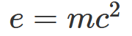
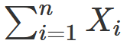
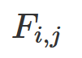
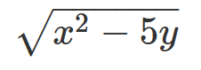
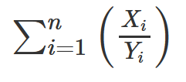
Markdown basics
$e=mc^2$
Markdown supports Latex equations.
$equation$ is inline with text
$$equation$$ is as a separate block
$\sum_{i=1}^n X_i$
$F_{i,j}$
$\sqrt{x^2 - 5y}$
$\sum_{i=1}^{n}\left( \frac{X_i}{Y_i} \right)$

Slide 9
R code block details

Slide 10
Working directories
Working directories
Working directory is automatically set to directory with Rmd file
That’s why we immediately save
Designed so that data and code all go together
Can run setwd but get a warning, and only lasts for 1 block

Slide 11
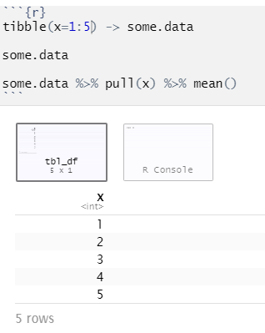
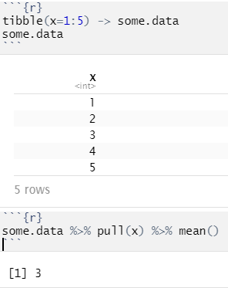
Good code block practices
Break code into short chunks
All chunks are part of the same session
Stop the block as soon as any output is generated

Slide 12
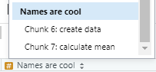
Good code block practices
Names are cool
--------------
```{r "create data"}
tibble(x=1:5) -> some.data
some.data
```
```{r "calculate mean"}
some.data %>% pull(x) %>% mean()
```
Name your chunks
Name appears in the navigation along with headings you’ve created

Slide 13
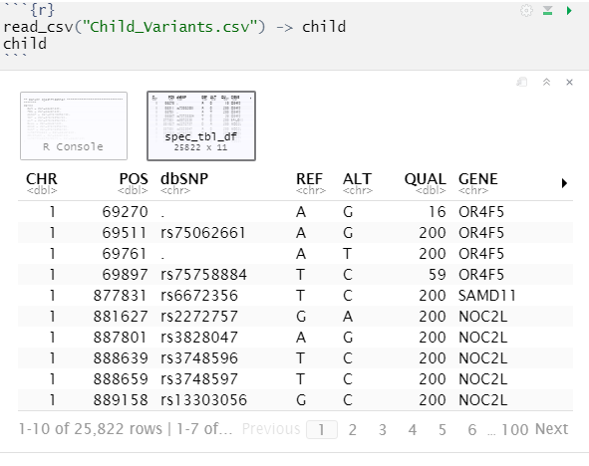
Displaying tibbles
By default you don’t see the text form of tibbles/dataframes
You get a nice interactive table
Not in all output formats
Buttons to see more columns/rows

Slide 14
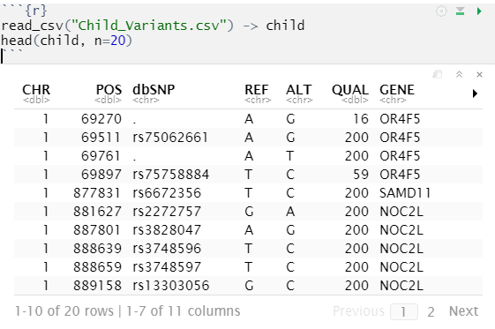
Displaying tibbles
Although you only see 10 rows, all of the data goes into your document
When rendered to HTML / PDF this can make your document BIG
Use the head() function to only show a few example rows

Slide 15
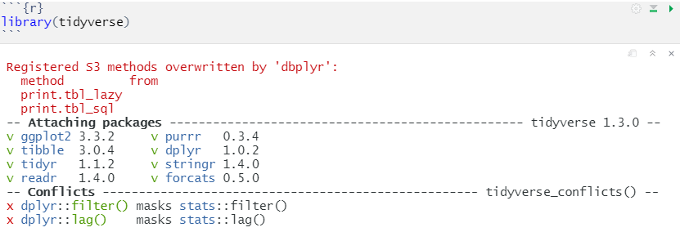
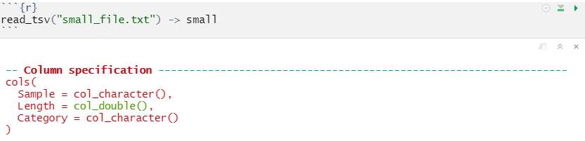
Controlling warnings / errors / messages

Slide 16
Controlling warnings / errors / messages
Can select which output you want to see using the block header
```{r "Block name", warnings=FALSE}
Can remove
Warnings {r warnings=FALSE}
Errors {r error=TRUE} means that script doesn’t stop on error
Messages {r message=FALSE}
Code {r echo=FALSE}
Code + output {r include=FALSE}

Slide 17
Changing graphics options
You can change the way that figures / graphs are displayed by changing R code block options
Change the file format (default is PNG)
```{r dev="svg"}
Change the size
```{r fig.height=5, fig.width=8}
Change the alignment (only affected compiled document)
```{r fig.align="center"}
Add a legend
```{r fig.cap="This is a great picture"}

Slide 18
Changing document appearance

Slide 19
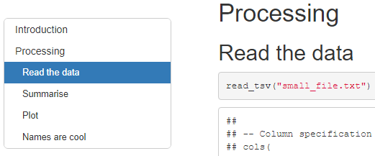
Table of Contents
If you have used headings in your document then you can auto-create a table of contents
This can be a fixed set of links at the top of your document, or a floating table on the left
This is set in the header section
---
title: "Example Notebook"
output:
html_document:
df_print: paged
toc: yes
toc_float: yes
---

Slide 20
Document themes
---
title: "Themes"
output:
html_document:
df_print: paged
toc: true
toc_float: true
theme: yeti
highlight: kate
---
HTML documents are based on the bootswatch theme collection (https://bootswatch.com)
You can change the theme by adding to the header

Slide 21
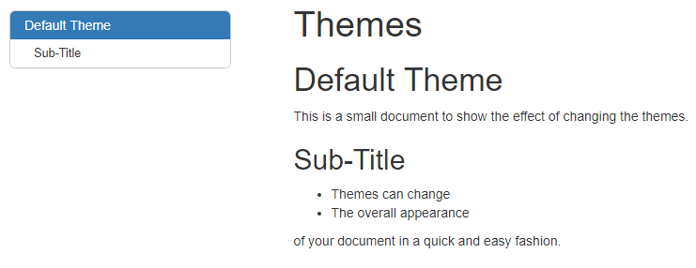
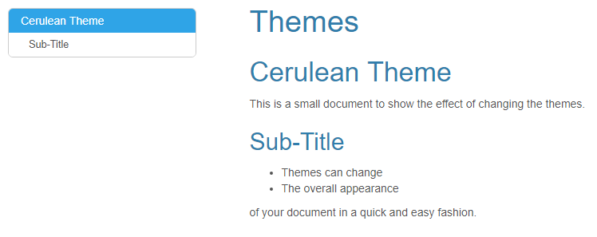
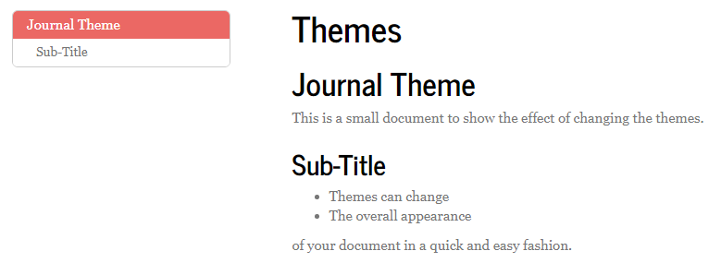
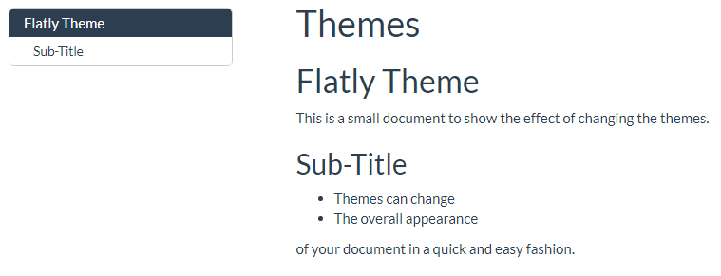
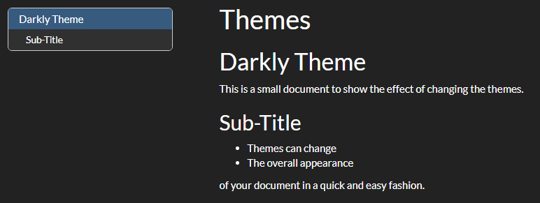
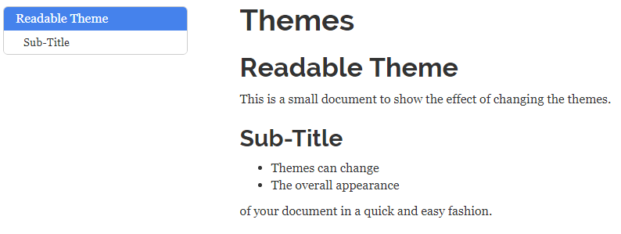
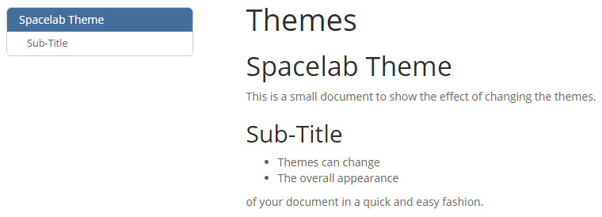
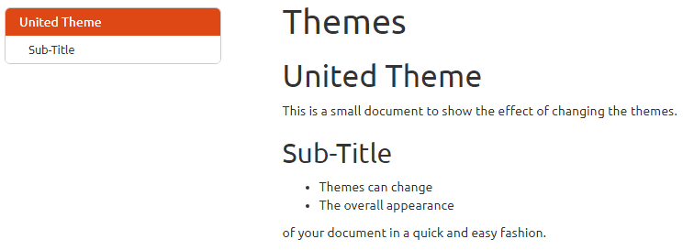
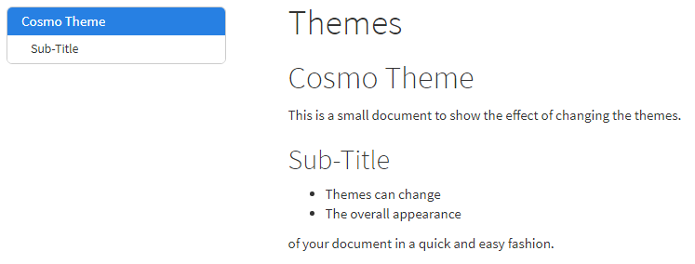
Document themes
(there are more than this)

Slide 22
Highlighting themes
---
title: "Themes"
output:
html_document:
df_print: paged
toc: true
toc_float: true
theme: yeti
highlight: kate
---
Similarly to the document themes you can also change the colouring / style used to highlight R code in your document

Slide 23
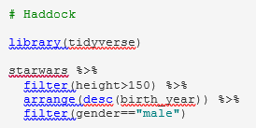
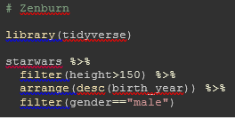
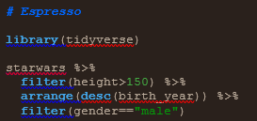
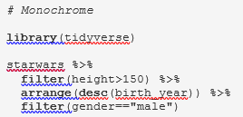
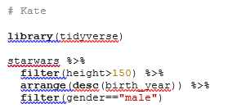
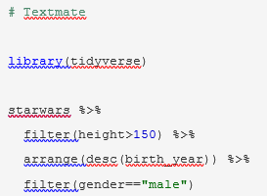
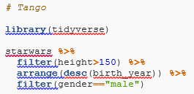
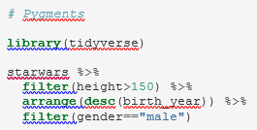
Highlighting themes

Slide 24
Tibble / DataFrame display options
Rather than text output you see an interactive HTML version of tibbles
This will vary by output document type
A few options exist for how they are displayed these are set in the header, and are specific to the HTML output type:
html_document:
df_print: paged

Slide 25
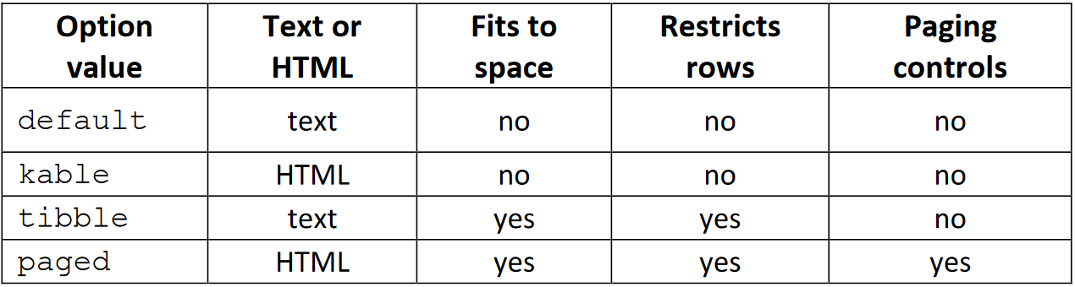
Tibble / DataFrame display options
Only works on data frames
This is the default

Slide 26
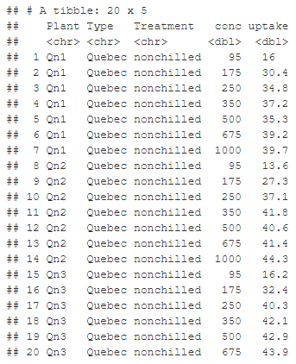
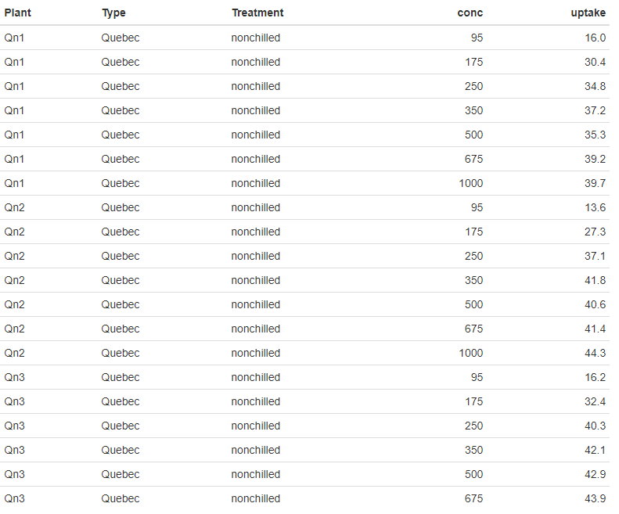
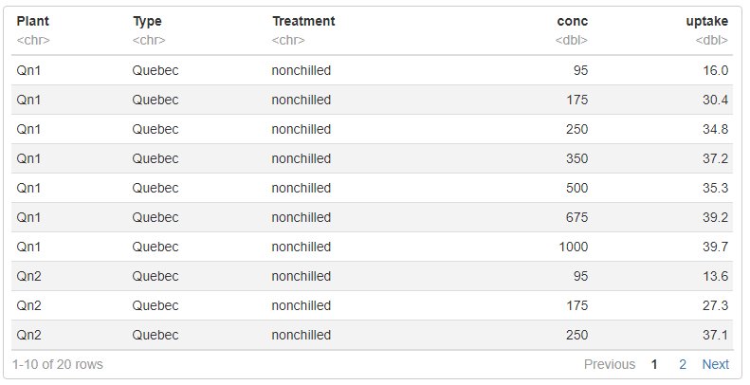
Tibble / DataFrame display options
Tibble
Kable
Paged

Slide 27
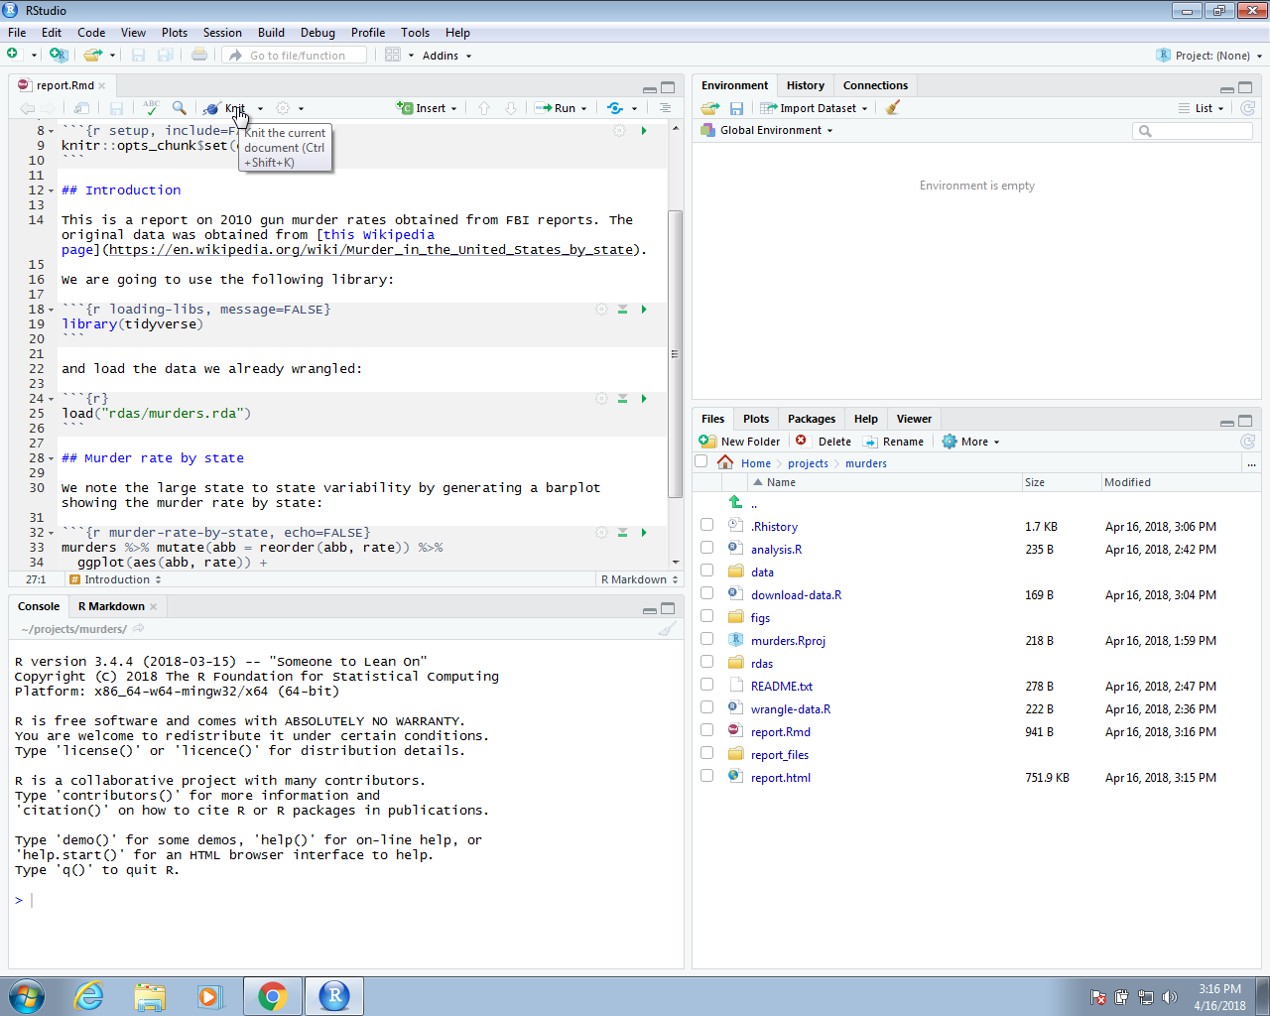
knitR
We use the knitR package to compile R markdown documents. The specific function used to compile is the knit function, which takes a filename as input. RStudio provides a button that makes it easier to compile the document.

Slide 28
Example
--- title: "Report on Gun Murders"
author: "Rafael Irizarry"
date: "`r format(Sys.Date())`"
output: github_document
---
```{r setup, include=FALSE}
knitr::opts_chunk$set(echo = TRUE)
```
## Introduction
This is a report on 2010 gun murder rates obtained from FBI reports. The original data was obtained from [this Wikipedia page](https://en.wikipedia.org/wiki/Murder_in_the_United_States_by_state). We are going to use the following library:
```{r loading-libs, message=FALSE}
library(tidyverse)
```
and load the data we already wrangled:
```{r} load("rdas/murders.rda")
```
## Murder rate by state
We note the large state to state variability by generating a barplot showing the murder rate by state:
```{r murder-rate-by-state, echo=FALSE}
murders %>% mutate(abb = reorder(abb, rate)) %>%
ggplot(aes(abb, rate)) + geom_bar(width = 0.5, stat = "identity", color = "black") + coord_flip()
```

Slide 29
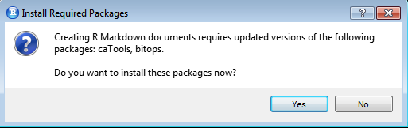
Knit button
The first time you click on the Knit button, a dialog box may appear asking you to install packages you need:
Once you have installed the packages, clicking the Knit will compile your R markdown file and the resulting document will pop-up:
This produces an html document which you can see in your working directory. To view it, open a terminal and list the files. You can open the file in a browser and use this to present your analysis. You can also produce a PDF or Microsoft document by changing:
output: html_document to output: pdf_document or output: word_document.

Slide 30
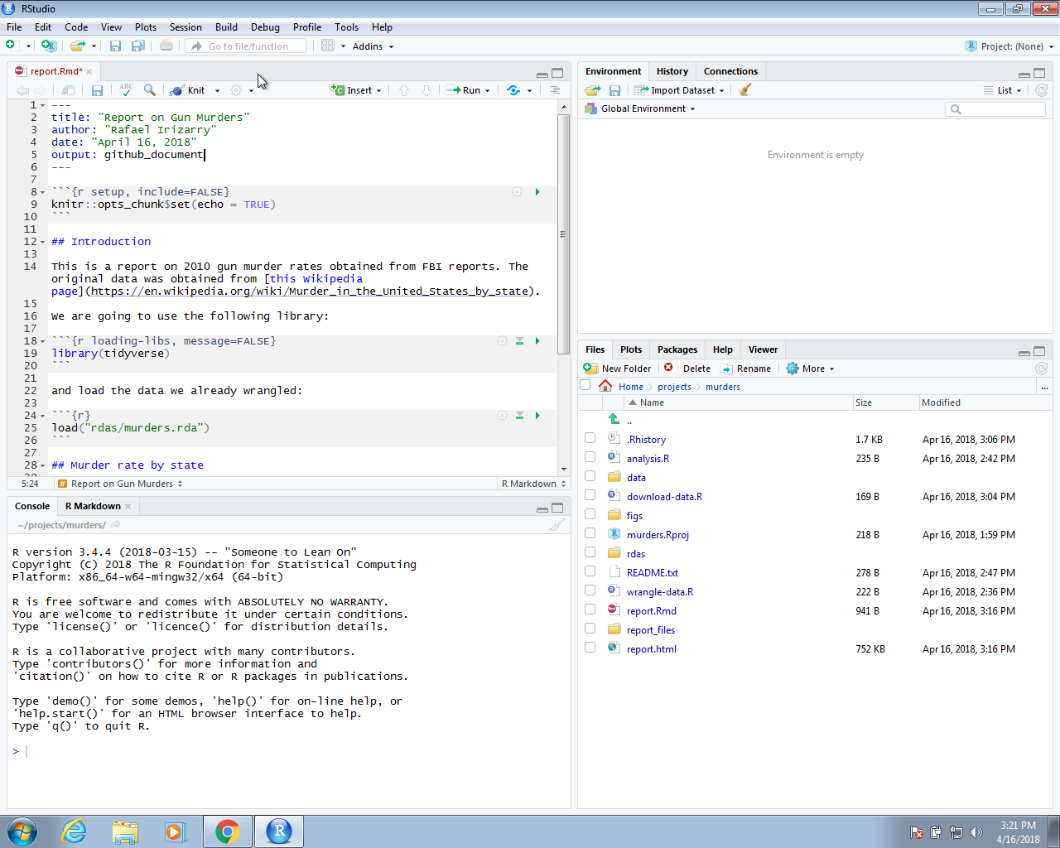
github_document
We can also produce documents that render on GitHub using output: github_document like this:

Slide 31
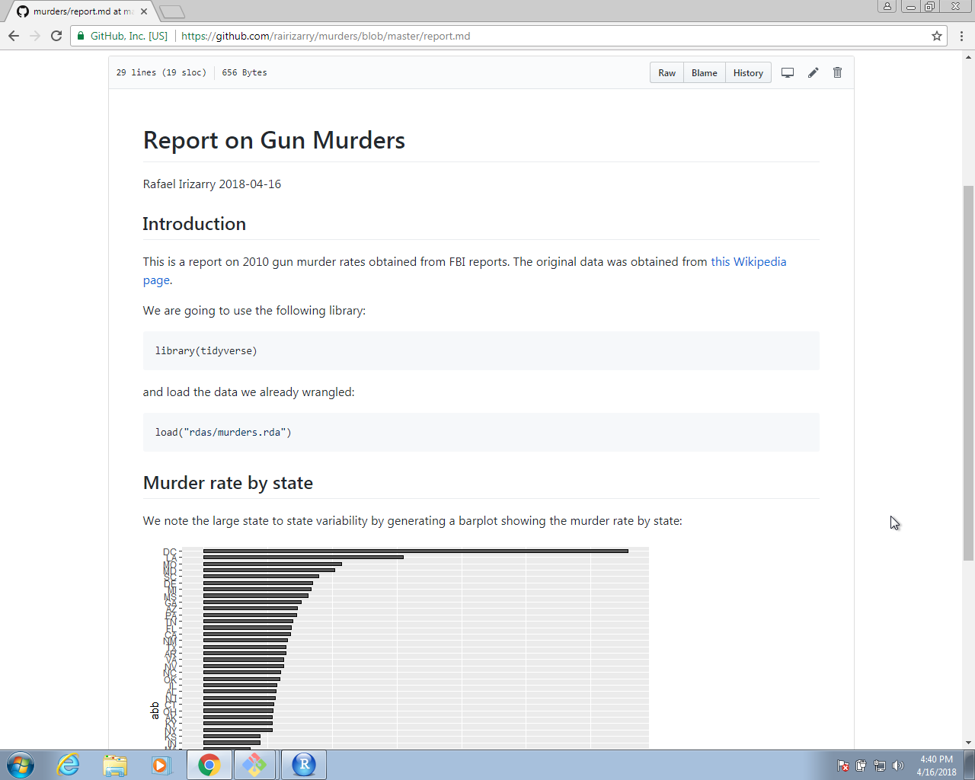
Web report
This will produce a markdown file, with suffix md, that renders in GitHub. Because we have uploaded these files to GitHub, you can click on the md file and you will see the report as a webpage:

Slide 32
Slide presentation
R Markdown renders to four presentation formats:
beamer_presentation - PDF presentations with beamer
ioslides_presentation - HTML presentations with ioslides
slidy_presentation - HTML presentations with slidy
powerpoint_presentation - PowerPoint presentation
revealjs::revealjs_presentation - HTML presentations with reveal.js
Each format will intuitively divide your content into slides, with a new slide beginning at each first or second level header.

Slide 33
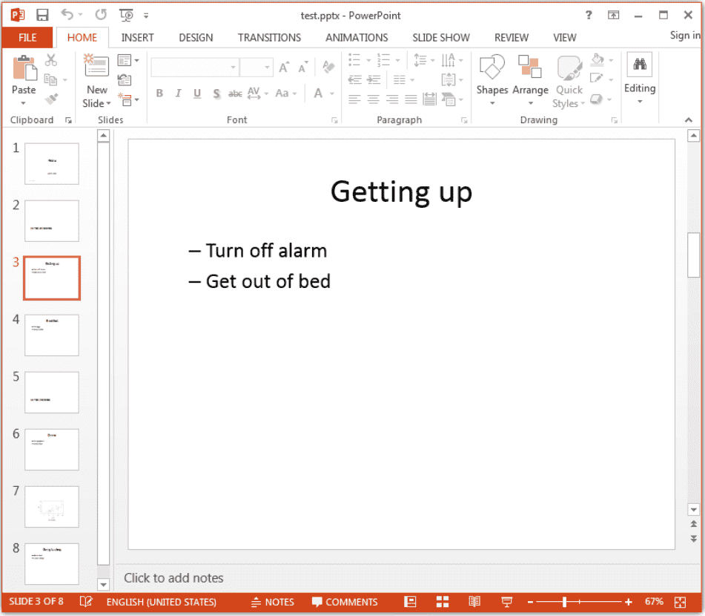
Power Point
--- title: "Habits"
author: John Doe
date: March 22, 2005
output: powerpoint_presentation
---
# In the morning
## Getting up
Turn off alarm
Get out of bed
## Breakfast
Eat eggs
Drink coffee
# In the evening
## Dinner
Eat spaghetti
Drink wine
---
```{r, cars, fig.cap="A scatterplot.", echo=FALSE}
plot(cars)
```
## Going to sleep
Get in bed
Count sheep

Slide 34
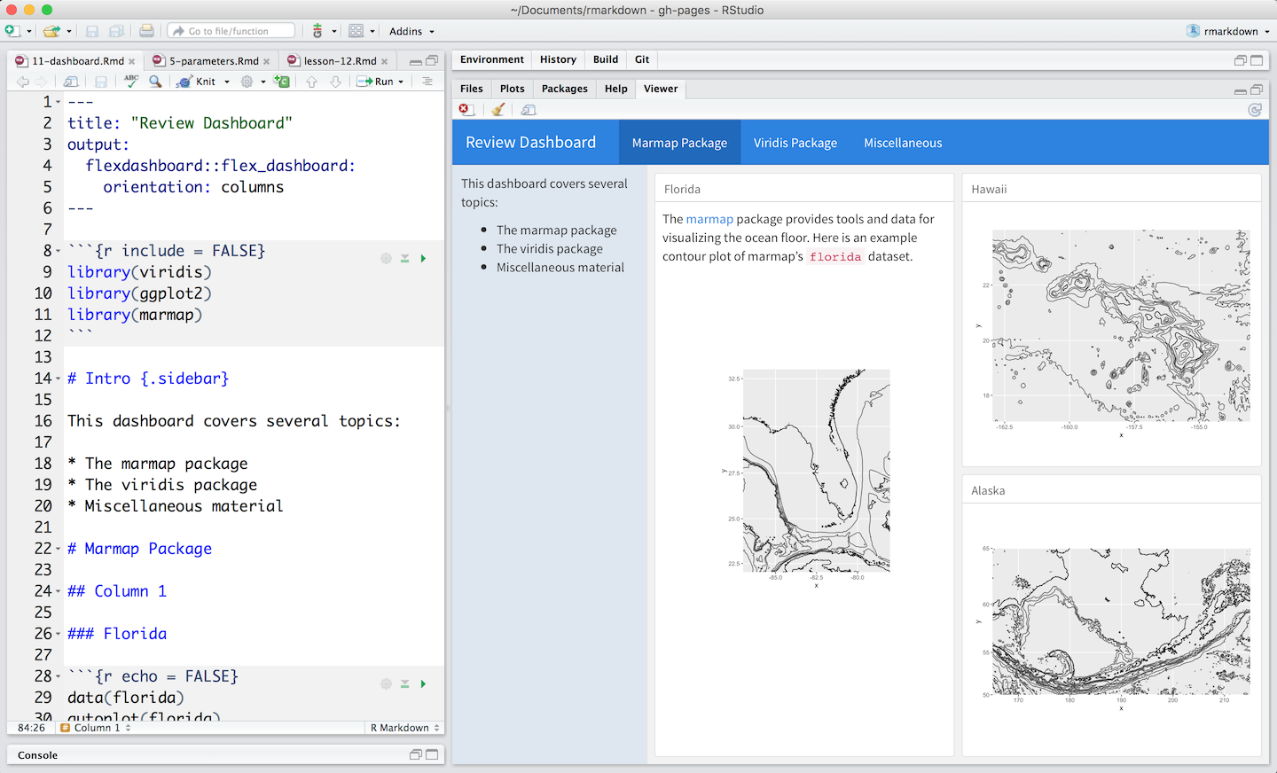
Dashboard
Dashboards are a useful way to communicate large amounts of information visually and quickly. Create one with the flexdashboard::flex_dashboard output format
Flexdashboard makes it easy to organize your content into a visual layout:
Each Level 1 Header (#) begins a new page in the dashboard.
Each Level 2 Header (##) begins a new column.
Each Level 3 Header (###) begins a new box.

Slide 35
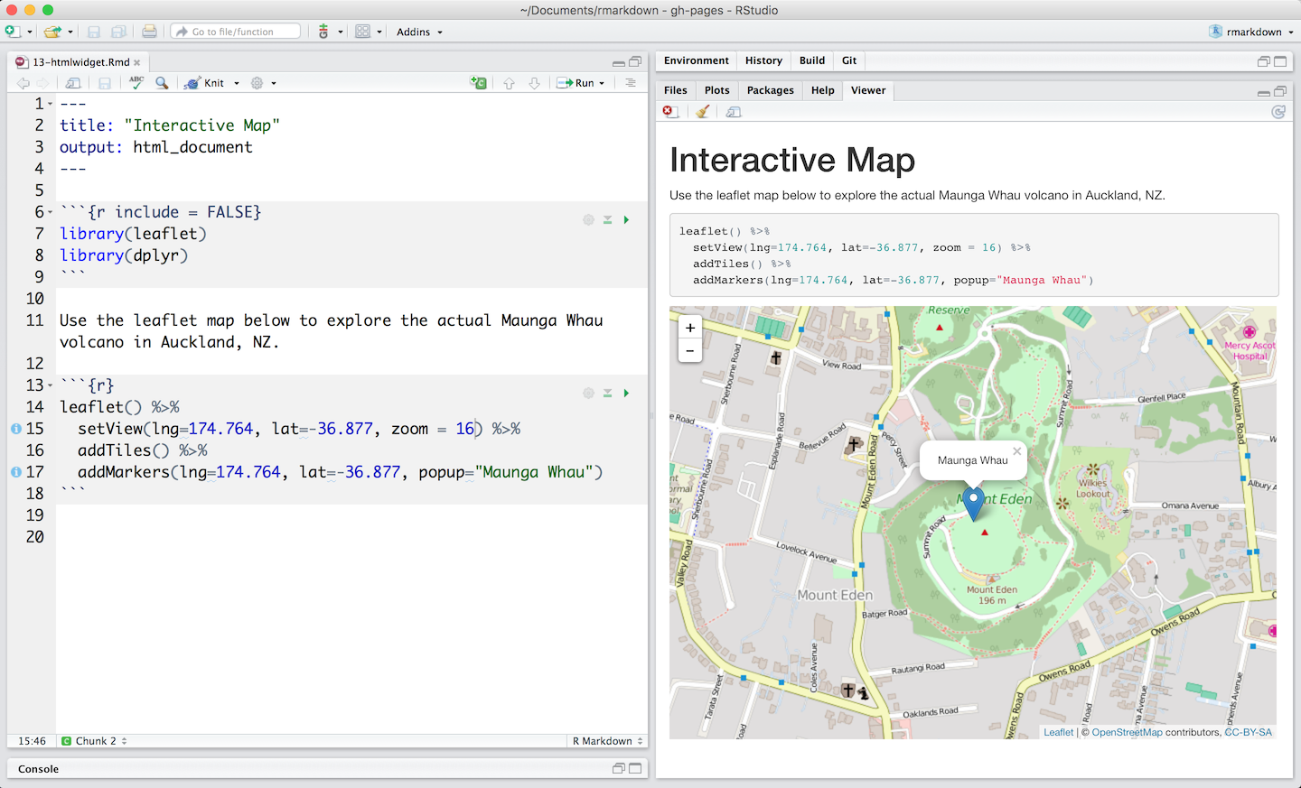
Interactive documents
Markdown documents are a perfect platform for interactive content. To make your documents interactive, add:
Interactive JavaScript visualizations based on htmlwidgets or
Reactive components made with Shiny

Slide 36
Shiny apps

Slide 37
Shiny
Shiny is an R package that makes it easy to build interactive web apps straight from R.
You can host standalone apps on a webpage or embed them in R Markdown documents or build dashboards.
You can also extend your Shiny apps with CSS themes, htmlwidgets, and JavaScript actions.
web apps was for R users:
In the past
With shiny
You need a deep knowledge of web technologies like HTML, CSS and JavaScript.
Making complex interactive apps requires careful analysis of interaction flows to make sure that when an input changes, only the related outputs are updated.
Providing a carefully curated set of user interface (UI for short) functions that generate the HTML, CSS, and JavaScript that you need for common tasks.
Introducing a new style of programming called reactive programming which automatically tracks the dependencies of a code chunk.
Notes:
This means that you don’t know need to know the details of HTML/CSS/JS until you want to go beyond the basics that Shiny provides for you.
This means that whenever an input changes, Shiny can automatically figure out how to do the smallest amount of work to update all the related outputs.

Slide 38
Every Shiny app is maintained by a computer running R

Slide 39
Introduction
Two key components of every Shiny app:
the UI (short for user interface) which defines how your app looks,
the server function which defines how your app works. Shiny uses reactive programming to automatically update outputs when inputs change so we’ll finish by learning the third important component of Shiny apps: reactive expressions.
install.packages("shiny")
library(shiny)

Slide 40
Build your app

Slide 41
Inputs

Slide 42
Inputs

Slide 43
Syntax

Slide 44
Other inputs

Slide 45
Outputs

Slide 46
Outputs

Slide 47
Outputs

Slide 48
how to assemble inputs into outputs ?

Slide 49
Server function

Slide 50
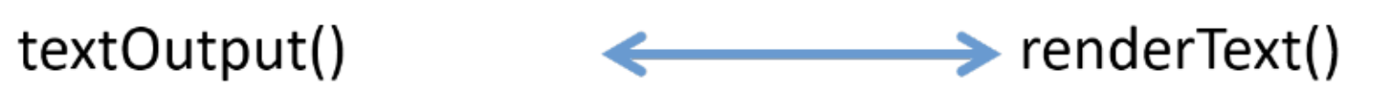
Render
Output function in UI code pairs with a render function in the server code.

Slide 51
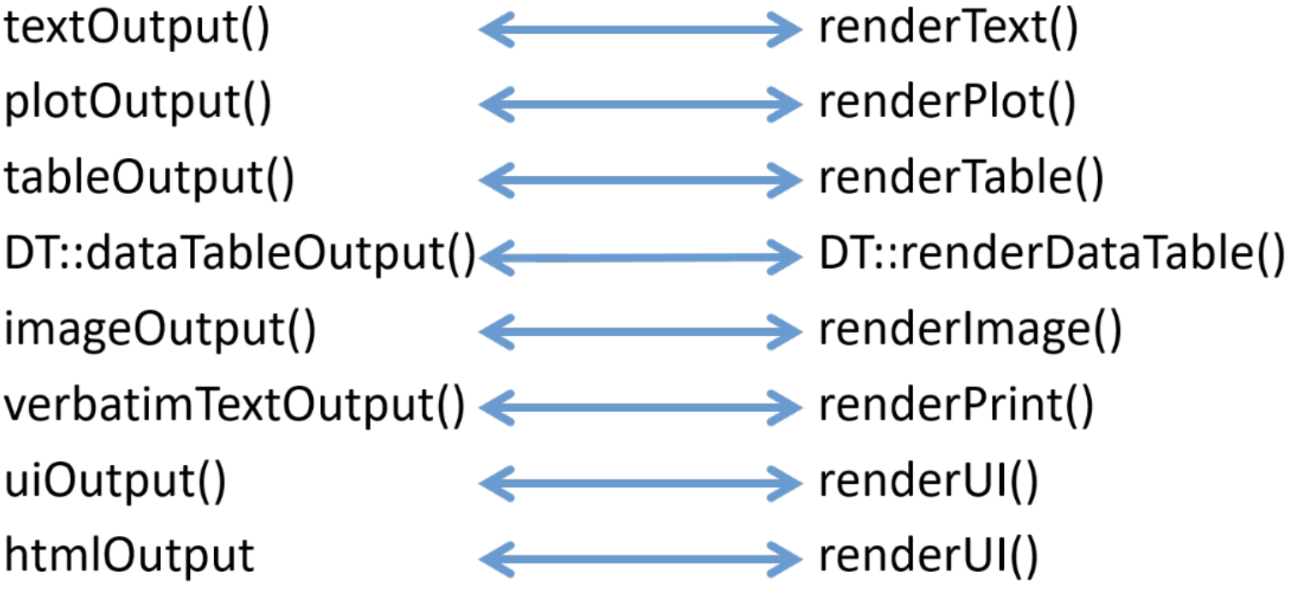
Outputs and render functions

Slide 52
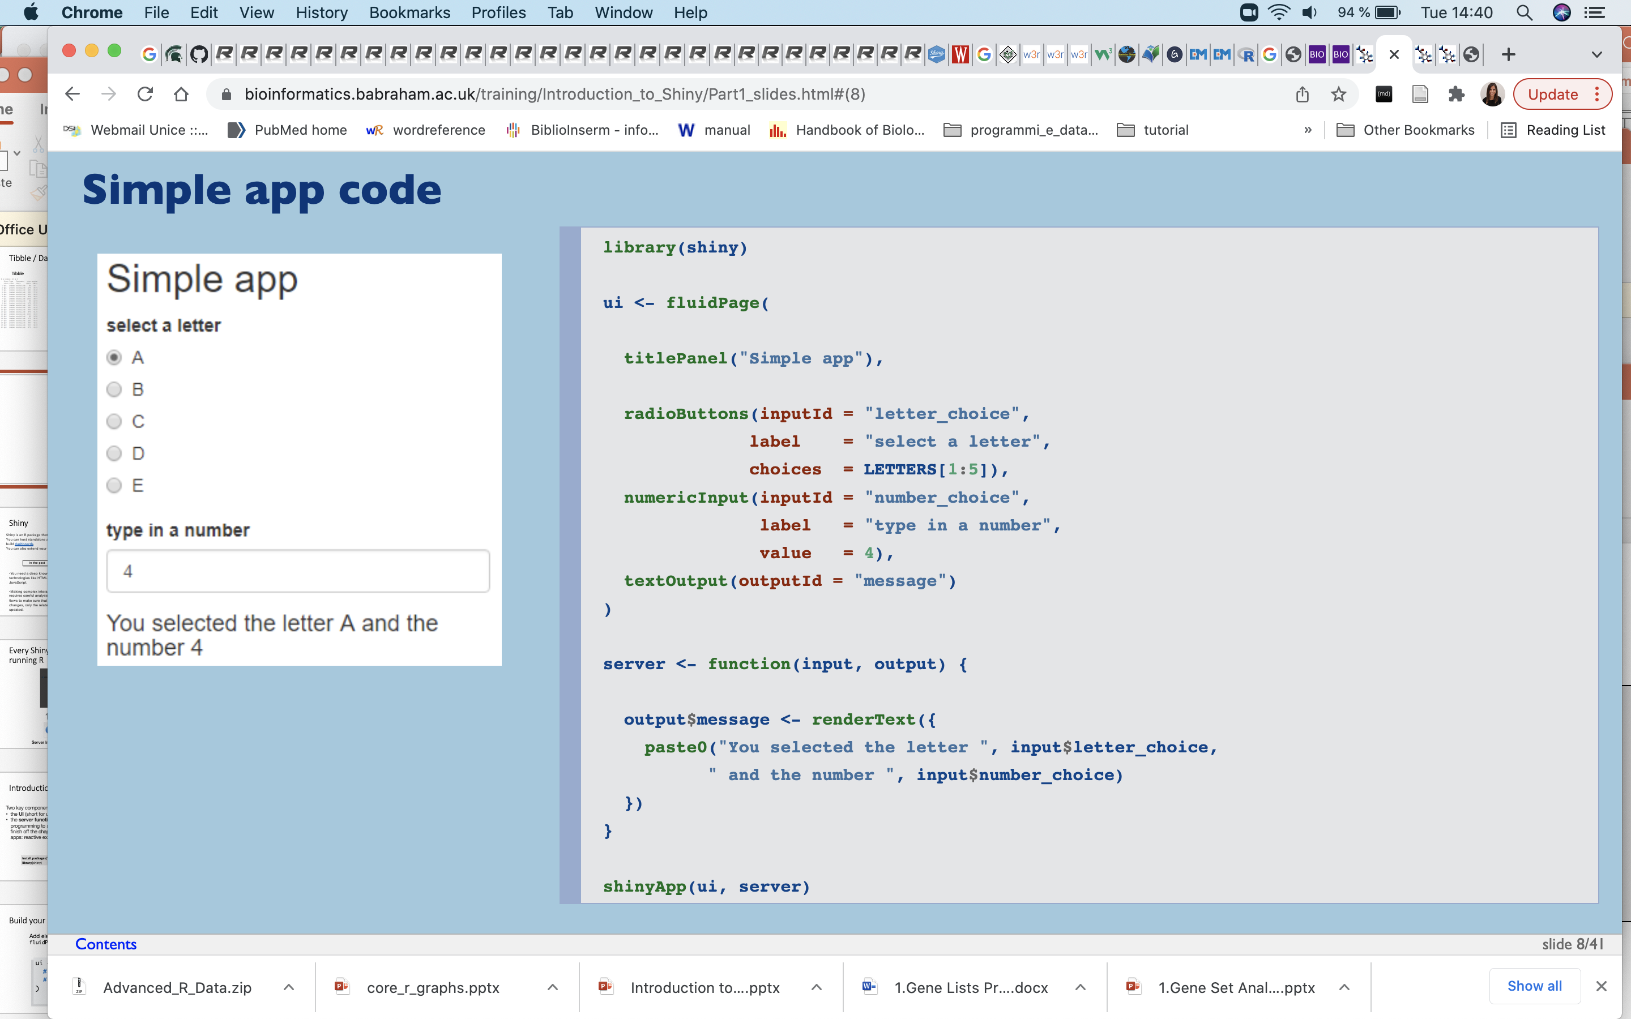
Simple app code

Slide 53
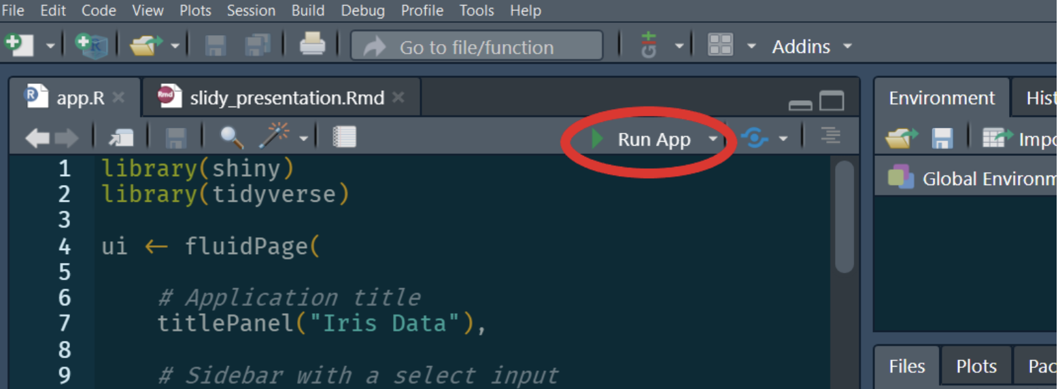
How to run a shiny app?

Slide 54
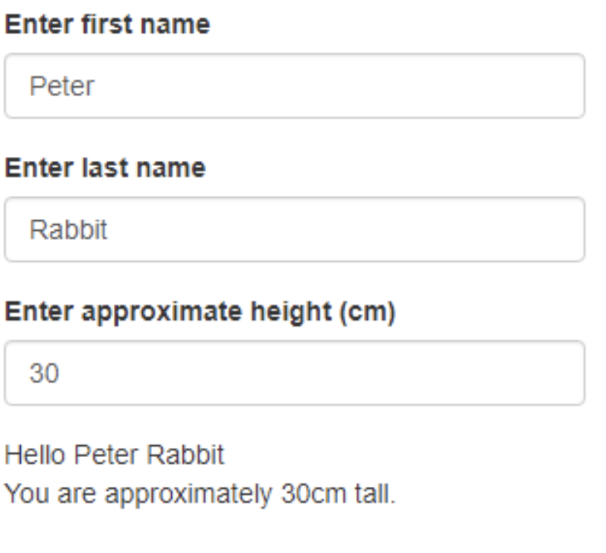
Exercise 1
Create a Shiny application from scratch that looks (and functions) like the one below.
There should be 2 textInput fields for entering user names, and one numericInput for entering height
The message at the bottom should display the first and last names entered by the user, along with their height
Add some radio buttons to allow users to select age brackets
Change the height selector to a slider
Feel free to add extra info fields

Slide 55
Two inputs

Slide 56
Two outputs

Slide 57
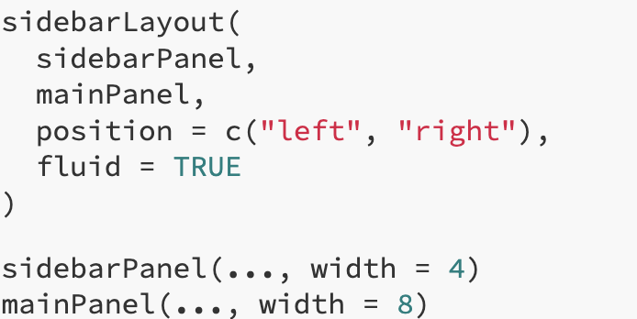
Side bar layouts - syntax

Slide 58
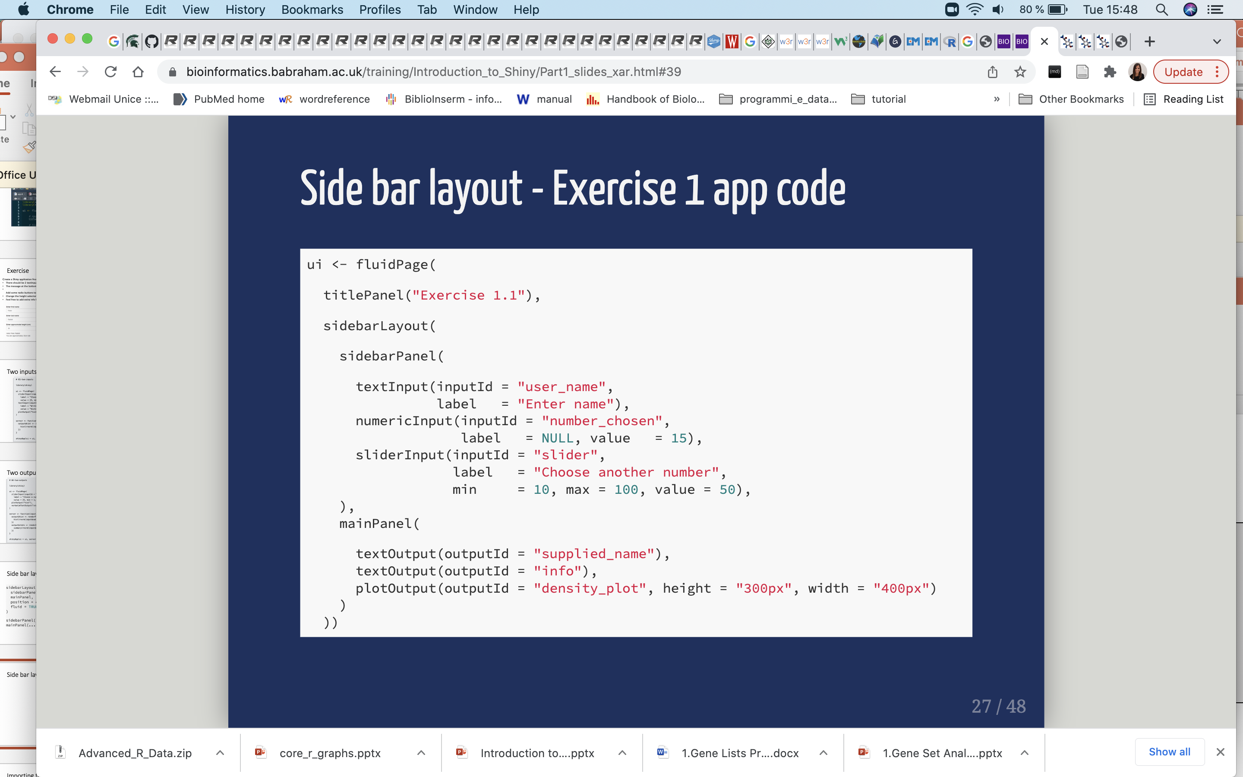
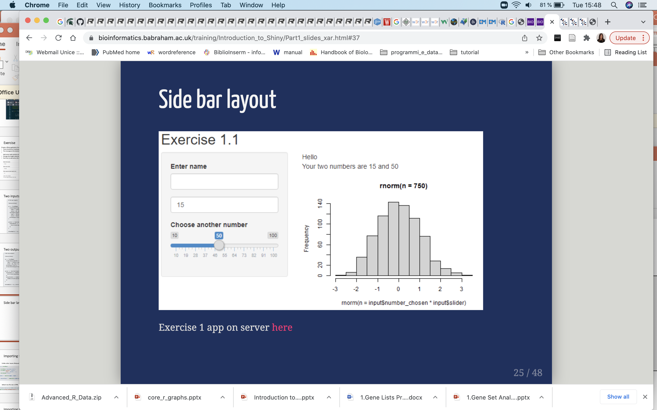
Side bar layouts - example

Slide 59
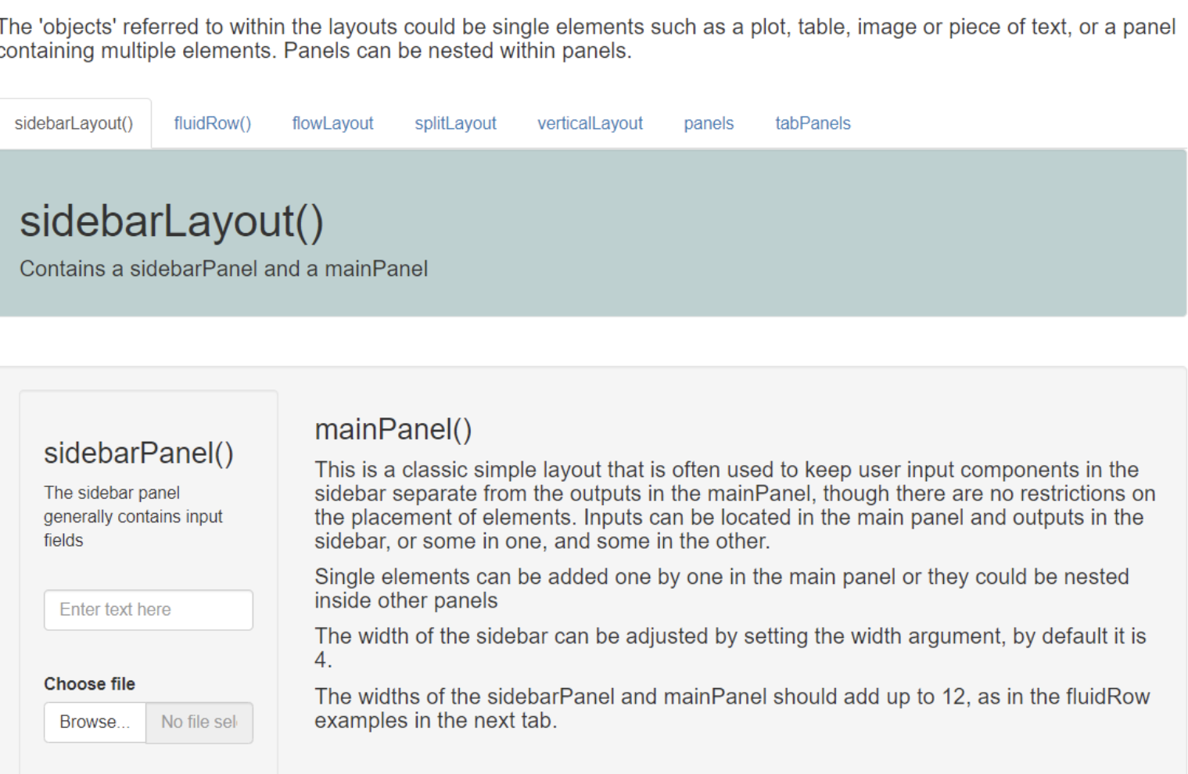
Layout examples

Slide 60

Importing files – fileInput()
Unlike other inputs, fileInput() returns a data frame with 4 columns
default max file size is 5MB

Slide 61

Importing files – fileInput()

Slide 62

Importing files – fileInput()

Slide 63

Pre-processing datasets

Slide 64

Exercise 2
Uploading a file.
Create an app that looks like this one. It should: - allow a csv file to be chosen and uploaded - display the first few rows of data in a table - have an option to change the number of rows displayed

Slide 65
Reactivity

Slide 66
Two outputs with reactive()

Slide 67
Can we prevent the title field from updating the plot?

Slide 68
Can we prevent the title field from updating the plot?

Slide 69

Reactive expressions and observers

Slide 70
Action buttons

Slide 72
Action buttons

Slide 75
Summary

Slide 76

Exercise 3

Slide 77

Exercise 4
Create an app that looks like this one, it should:
Import the advs.csv file.
Provide drop down lists of variables to plot on x and y axes.
Filter data based on the selected subject and parameter.

